Slide 1
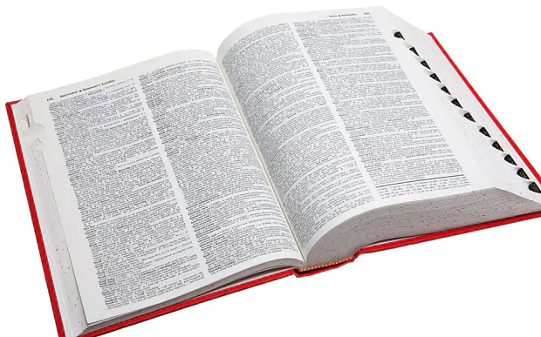
English-Geek General Language Dictionary

Slide 2
Project History
Starting point: 2002
Status: private project financed by Sideris Publications
Personnel: 11 editors in total

Slide 3
Entries
More than 17,000
Single- and multi-word
Differentiated by morphology and part of speech

Slide 4
Derivatives
Independent lemmas
Sub-lemmas, when meaning or/and usage is straightforward

Slide 5
Info by lemma
Phonetic transcription (simplified IPA)
approve //
Alternative lemmas
dryer και drier
Senses
Sub-lemmas

Slide 6
Info by sense (1)
Syntactic collocates
deliberate [about, on, over]
Part of speech
    v t v i v t, i aux v mod v
    n <C> n <U> n <C, U>
    n sing n pl pron
    adj adj gr adv
    det numb conj
    prep interj

Slide 7
Info by sense (2)
Irregular types
apply [applies, applying, applied]
echo pl echoes
I pl we
muddy [muddier, muddiest]

Slide 8
Info by sense (3)
Language variety: BrE vs AmE
Register: frm, infm, old-fash, rude, slang
Topic: arts, sciences, sports, etc.

Slide 9
Info by sense (4)
Greek translation
Phrasal verbs
Expressions/idioms with translation

Slide 10
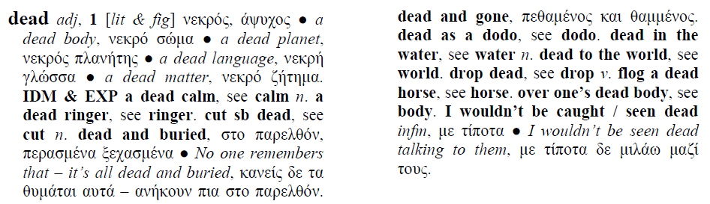
Expressions & idioms
Arranged alphabetically
Accompanied by examples

Slide 11
LexMC – Raw material
Convert source files to manageable content, i.e. xml
Select appropriate xml editor(s)
Create syntactically correct xml files and manage format changes, e.g. character encoding

Slide 12
LexMC – Processed material
Handle links to other resources or complementary files
Specify the morphology representation
Ensure correct format and consistency when editing/correcting/proof-reading
Enrich content with updates

Slide 13
LexMC – Presentation
Create a digital content representation with the appropriate structure resulting in a user-friendly environment
Reach as many end users as possible

Slide 14




Thank you!
About your speakers:
  Anna Vakalopoulou
  ILSP / Athena RIC
  Maria Koutsombogera
  Trinity College Dublin

